Slide 1

EECE381 Module2
Group 9

Slide 2
Goals
Draw on Android Phone/Tablet
Sync Drawing with VGA Display
TCP Connection
Mirror Drawing from Android Device & VGA Display

Slide 3
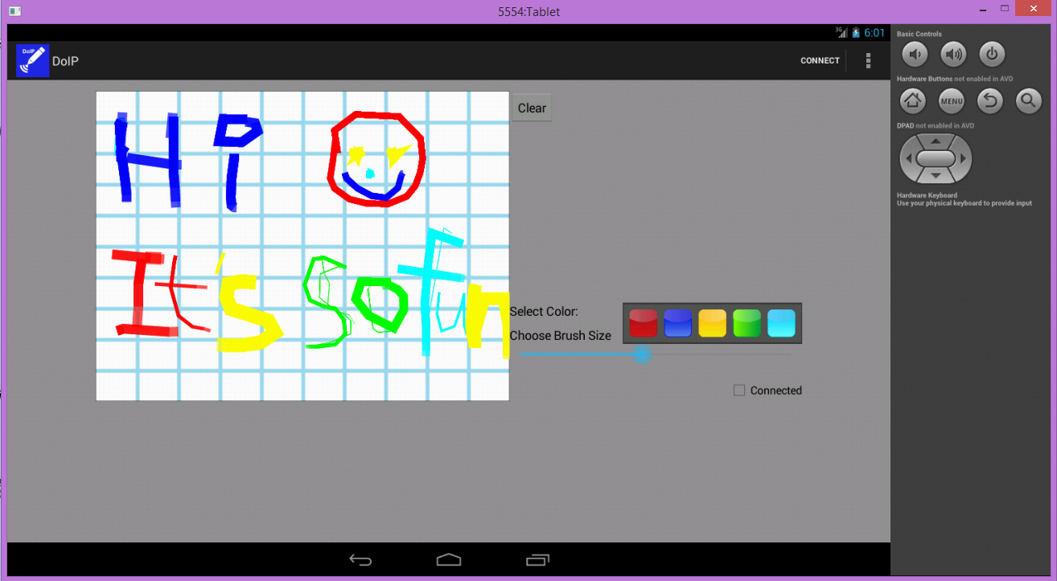
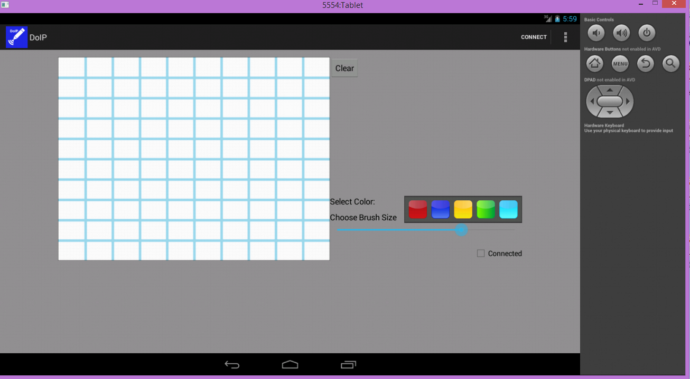
Introduction

Slide 4
Features
Draw Freely
Brush Color
Brush Size
Clear the Drawing
Send the Drawing
Sync Drawing on Android Device with VGA Display

Slide 5
Show Time…

